Slide 1
Predicting Profit of Startup Company Professor: Luca Oneto "Statistic is a way to measure the uncertainty of the world" Luca Oneto

Slide 2
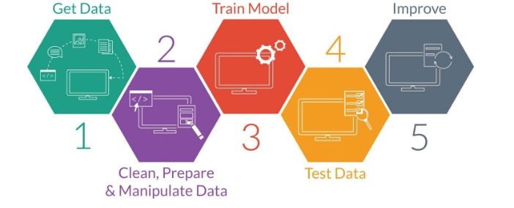
Objective

Slide 3

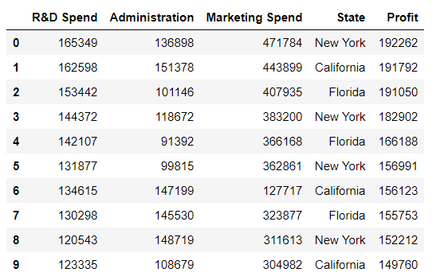
Goal of the Project
Aim of the project is to predict the profit of startup company, based few metrics as Research & development, Administration, Market Spend, State, Profit.
(50,5)

Slide 4





Technologies

Slide 5

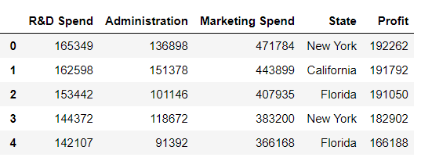

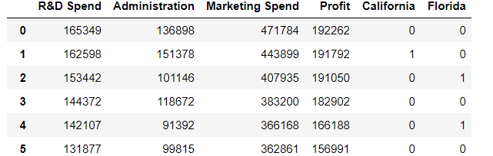
Pre-Processing Data
-Do we have missing values ?
-No
Handling categorical variables (Dummy variables)

Slide 6
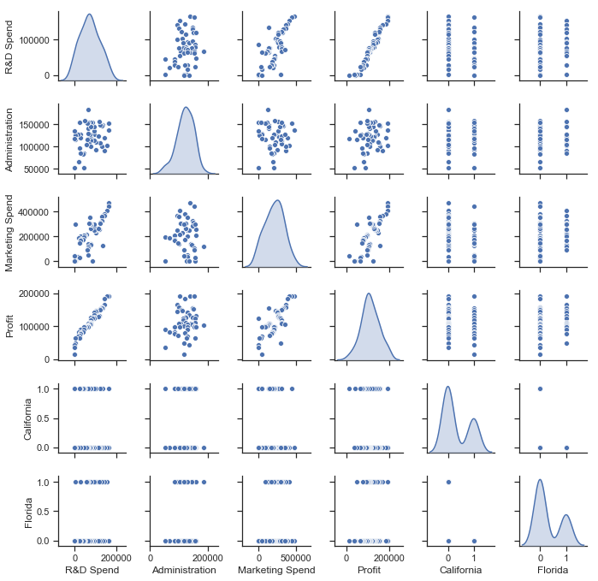
Scatter plot matrix

Slide 7
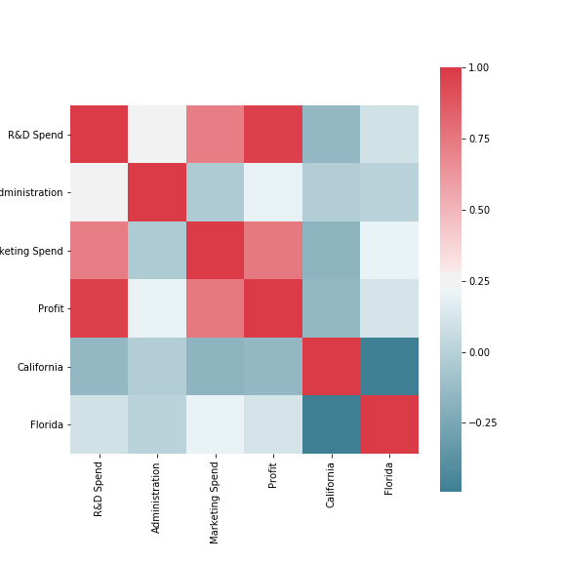
Correlation matrix

Slide 8

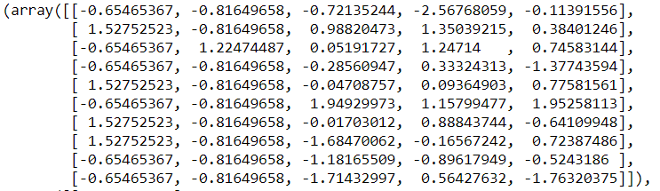
Scaling data

Slide 9
Cross validation
Cleaned Data
Training 80%
Test 20%

Slide 10
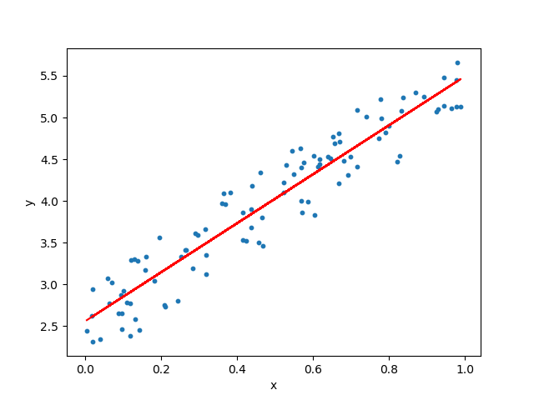
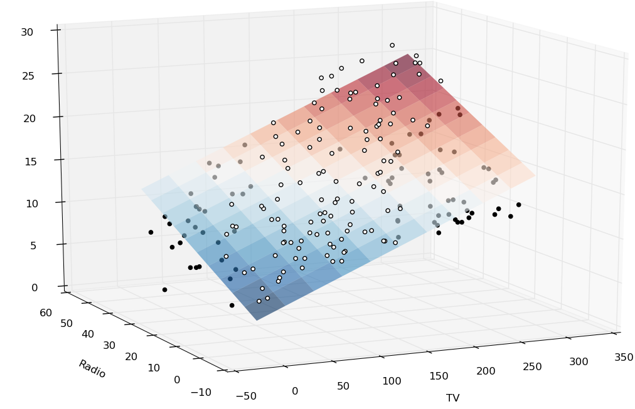
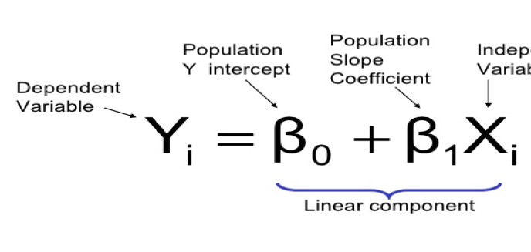
Model and Evaluation
Linear Regression: Simple linear regression is useful for finding relationship between two continuous variables One is predictor or independent variable and other is response or dependent variable.
root mean square error and the r^2 score are used to evaluate the model.
The root mean square error in our case is 0.2914
Training: 0.945848
Testing: 0.915068

Slide 11
Regularization
This is a form of regression, that constrains/ regularizes or shrinks the coefficient estimates towards zero by adding a little bias and that reduces variance to avoid the risk of overfitting.
λ is the tuning Hyperparameter that decides how much we want to penalize the flexibility of our model. When λ = 0, the penalty term has no eﬀect.
This Hyperparameter has to learn from cross validation.
Ridge (L2) and Lasso (L1) regression are some of the simple techniques to reduce model complexity and prevent over-fitting which may result from simple linear regression.
Grid-searching is the process of scanning the data to configure optimal parameters for a given model. Grid-searching can be applied across models to calculate the best parameters to use for any given model.

Slide 12
Regularization
Ridge regression shrinks the coefficients and it helps to reduce the model complexity and multi-collinearity. Ridge hyperparameter (0.001)
Lasso regression not only helps in reducing over-fitting but it can help us in feature selection. Lasso hyperparameter (0.03)
Training: 0.945848
Testing: 0.915068
Linear
Training: 0.944021
Testing: 0.926548
Lasso
Training: 0.945848
Testing: 0.915073
Ridge

Slide 13
Conclusion
We saw that there is a accuracy increased using regularization.
Regularization solves problem of fighting overfitting, multi-collinearity, reduce model complexity.
Regularization technique allows to decrease the variance at the cost of introducing some bias.
Finding a good bias-variance trade-off allows to minimize the model's total error.
Finding a best hyperparameter is very important as it may lead to wrong conclusions
Pay attention when we tune hyperparameter, tuning more than required may lead us to underfitting problem

Slide 14
Thanks!

